Slide 1





Tic-Tac-Toe

Slide 2




introduction
01.
Name: S M Uday Haider
Department of Electrical and
Computer Engineering
Student ID: 2512062642
02.
Name: Kanij Fatema Lubna
Department of Electrical and Computer Engineering
Student ID: 2512430642
03.
Name: Asifur Rahman Apon
Department of Electrical and Computer Engineering
Student ID: 2512131642
04.
Name: Safin Ahmed
Department of Electrical and Computer Engineering
Student ID: 2511967642

Slide 3

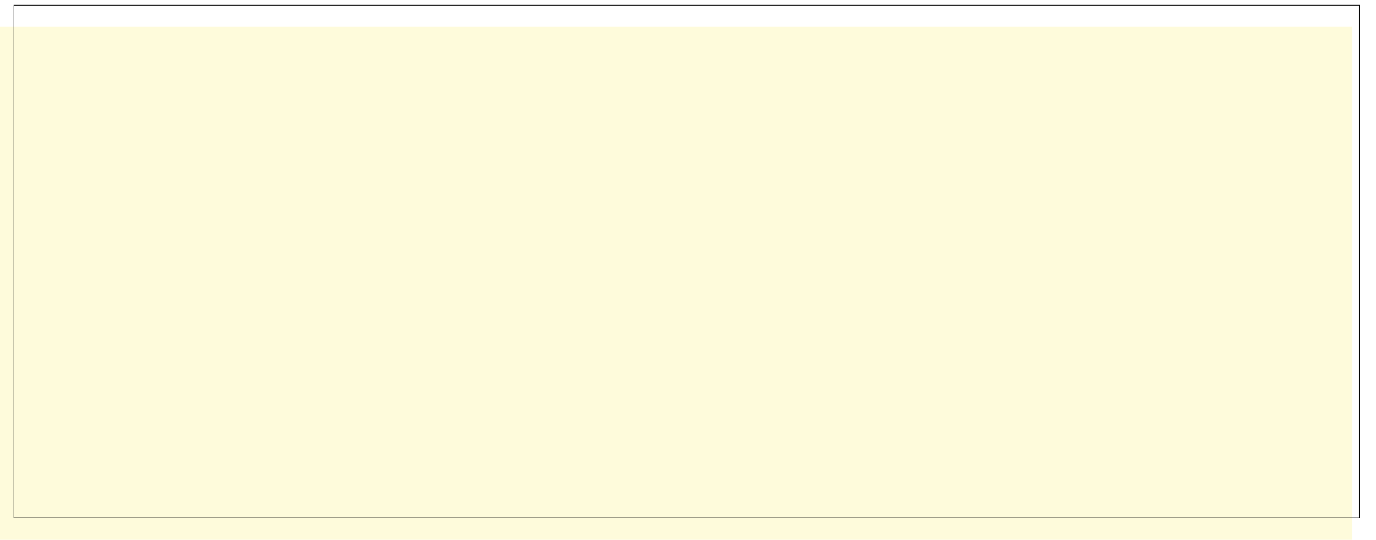
abstract
Developing a console based version of Tic- Tac- Toe game is the main goal of this project. There can be three cases of conclusion in a 3x3 grid: win, loss and draw. Different fundamentals of C programming are used for making the game logic and establishing the conclusions. They are: arrays, loops, functions and conditionals. It is an ideal project to understand C programming in more diverse applications.
Project: 02 Team Member: S M Uday Haider, Kaniz Fatema Lubna, Asifur Rahman Apon, Safin Ahmed

Slide 4
how to play?
On the console, the players will be asked to input a number from 1 to 9 one after another. Each number is assigned for each block of the game and as an output, ‘X’ will be shown in the first player’s preferred block and ‘O’ will be shown in the second player’s preferred block. The result will be declared as per the horizontal, vertical and diagonal blocks. The first player who will mark their signs accordingly wins the game.
Project: 02 Team Member: S M Uday Haider, Kaniz Fatema Lubna, Asifur Rahman Apon, Safin Ahmed

Slide 5


THE SYMBOLS
player 1
player 2
Project: 02 Team Member: S M Uday Haider, Kaniz Fatema Lubna, Asifur Rahman Apon, Safin Ahmed

Slide 6
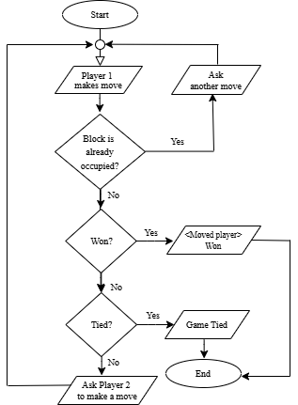

flowchart
Project: 02 Team Member: S M Uday Haider, Kaniz Fatema Lubna, Asifur Rahman Apon, Safin Ahmed

Slide 7
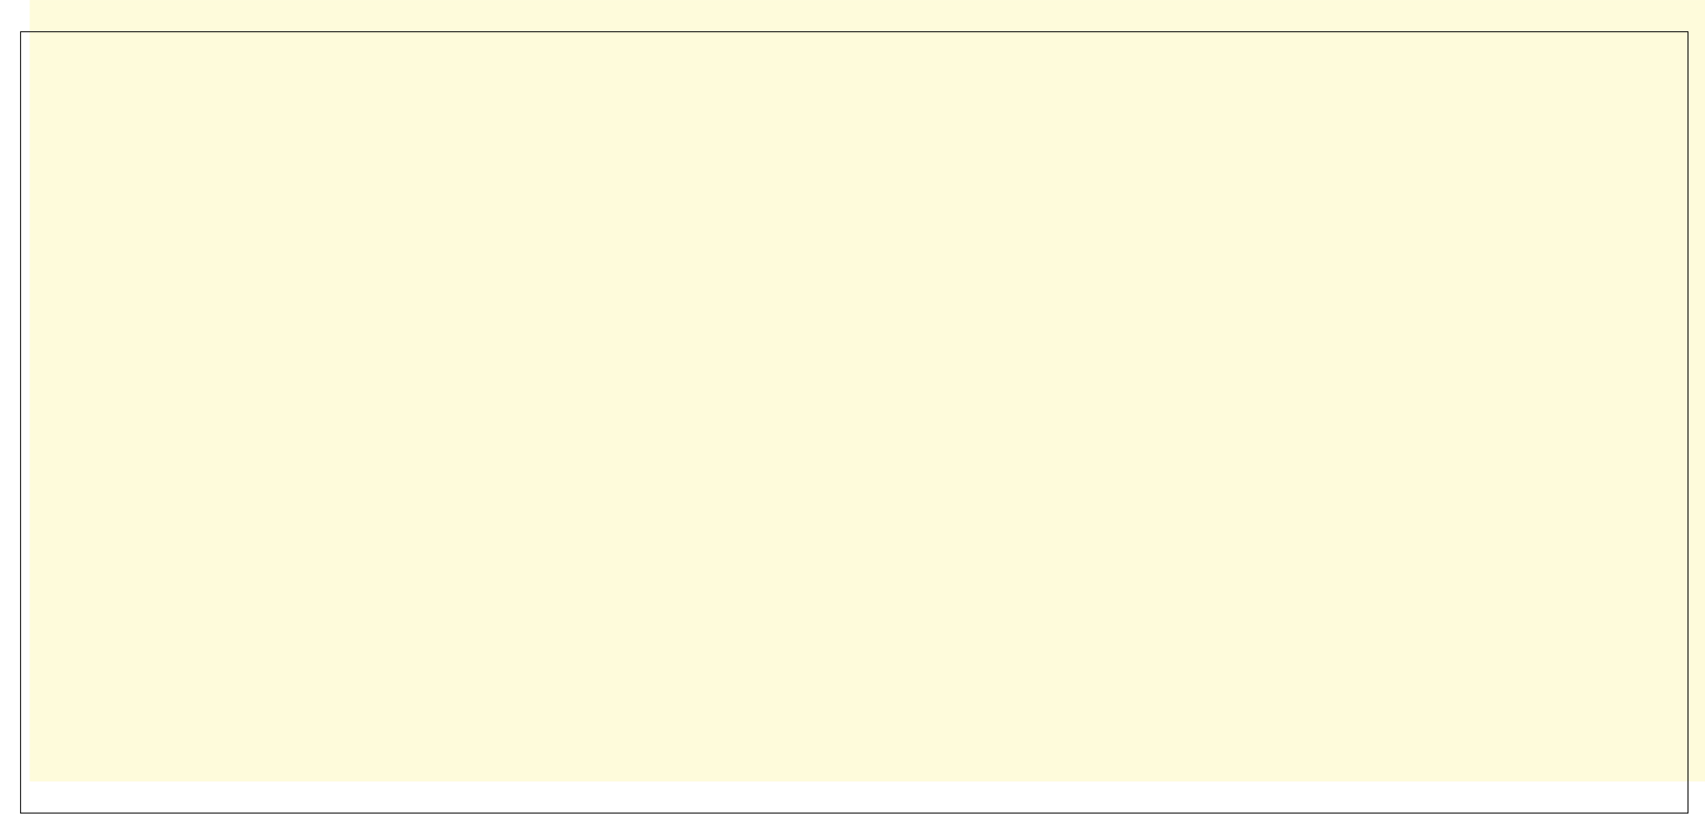
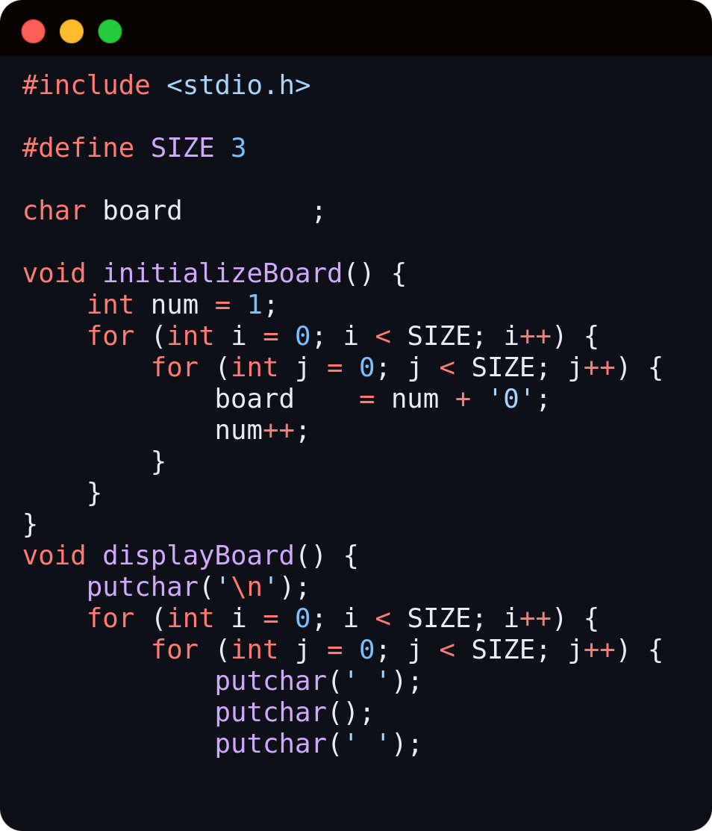
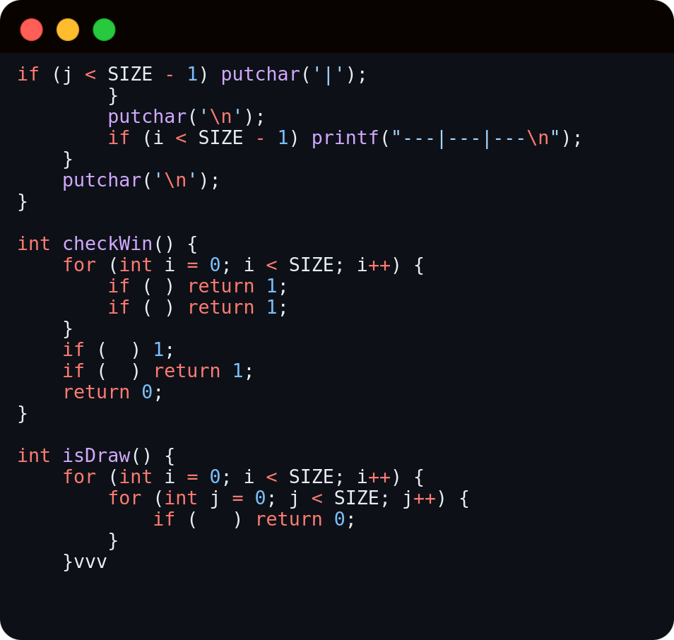
code structure
Project: 02 Team Member: S M Uday Haider, Kaniz Fatema Lubna, Asifur Rahman Apon, Safin Ahmed

Slide 8

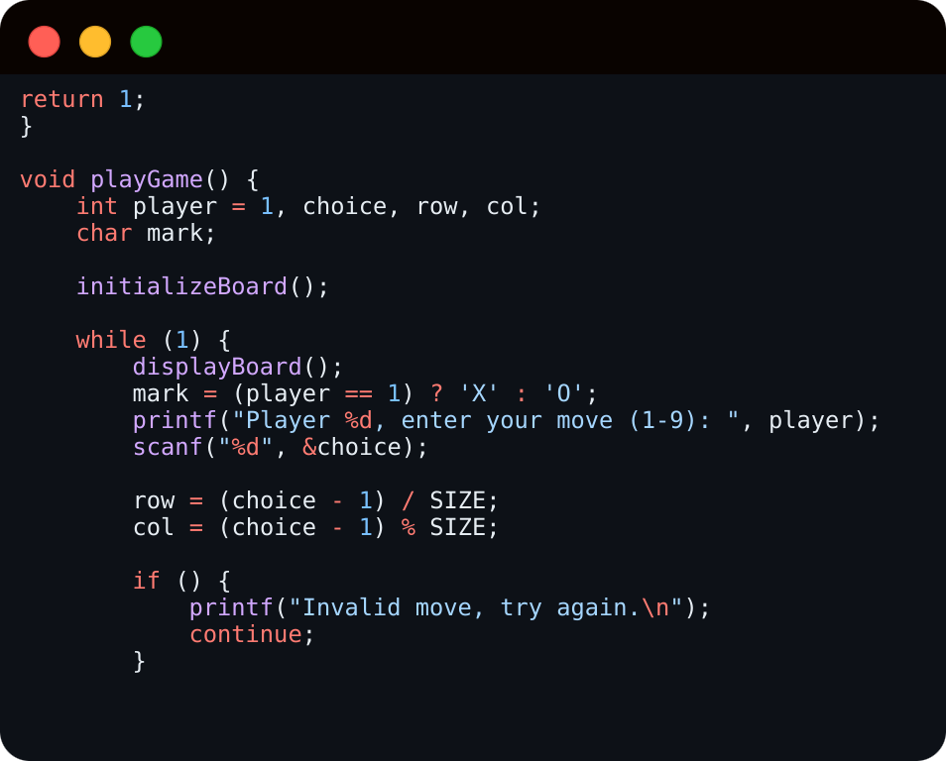
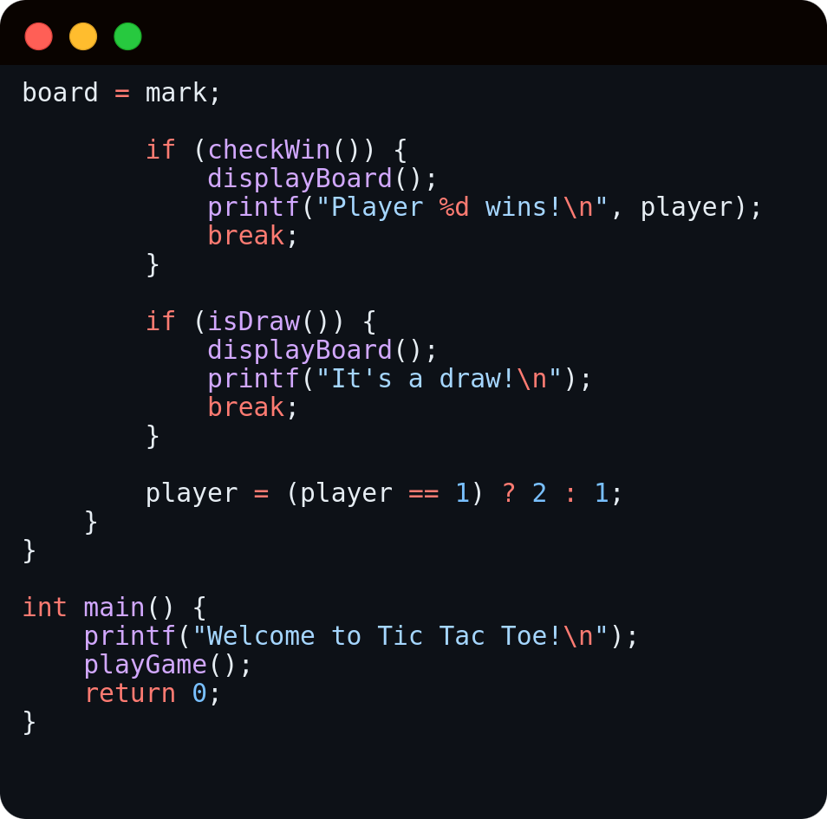
code structure
Project: 02 Team Member: S M Uday Haider, Kaniz Fatema Lubna, Asifur Rahman Apon, Safin Ahmed

Slide 9




issues
Invalid Inputs
Out-of- Range Inputs
Occupied Cell Selection
Project: 02 Team Member: S M Uday Haider, Kaniz Fatema Lubna, Asifur Rahman Apon, Safin Ahmed

Slide 10
solutions
Improve input handling
Ensure correct player turn management
Prevent infinite loops and crashes
Project: 02 Team Member: S M Uday Haider, Kaniz Fatema Lubna, Asifur Rahman Apon, Safin Ahmed

Slide 11


methodology
DEVELOPMENT APPROACH:
Board Representation
Game Flow
Input Handling
Conclusion Checking
FUTURE ENHANCEMENTS:
AI implementation
Implementing input handling GUI
Introducing network based multiplayer
Project: 02 Team Member: S M Uday Haider, Kaniz Fatema Lubna, Asifur Rahman Apon, Safin Ahmed

Slide 12
thank you :)

